Slide 1

Random effects
Felipe Buchbinder

Slide 2

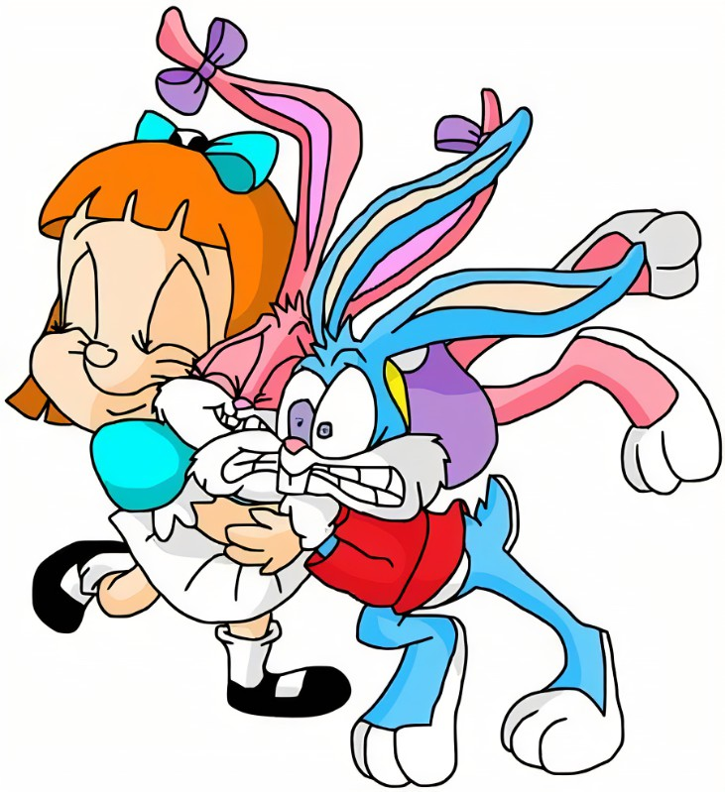
I fixed effects, but…
… it has a technical, mathematical, problem:

Slide 3


When $Cov\left(U_{i};X_{it}\right)=0$, it’s possible to find another estimate for$β$ that’s also unbiased but has a smaller variance

Slide 4
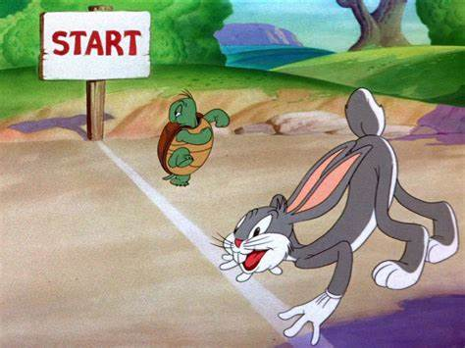

Competitive, heh?
If we already have an unbiased estimate for $β$, why do we care if there’s another one that has a smaller standard error?

Slide 5

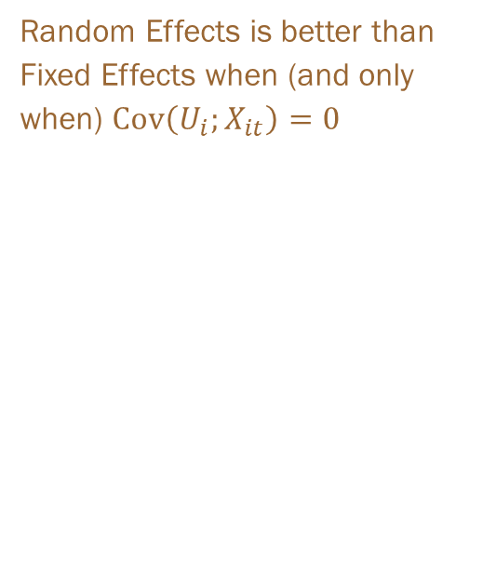
This estimator is the random effects estimator
Random Effects is better than Fixed Effects when (and only when) $Cov\left(U_{i};X_{it}\right)=0$

Slide 6
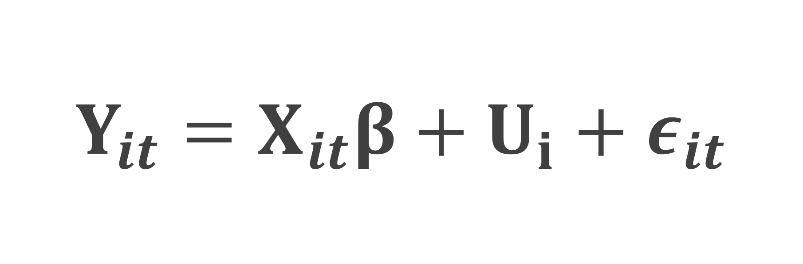
Start from the general equation of panel data
$$Y_{it}=X_{it}β+U_{i}+ε_{it}$$

Slide 7

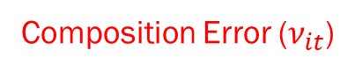
If we treat this as a usual regression, $U_{I}$ will be absorbed in the error term
$$Y_{it}=X_{it}β+U_{i}+ε_{it}$$
Composition Error ($ν_{it}$)

Slide 8
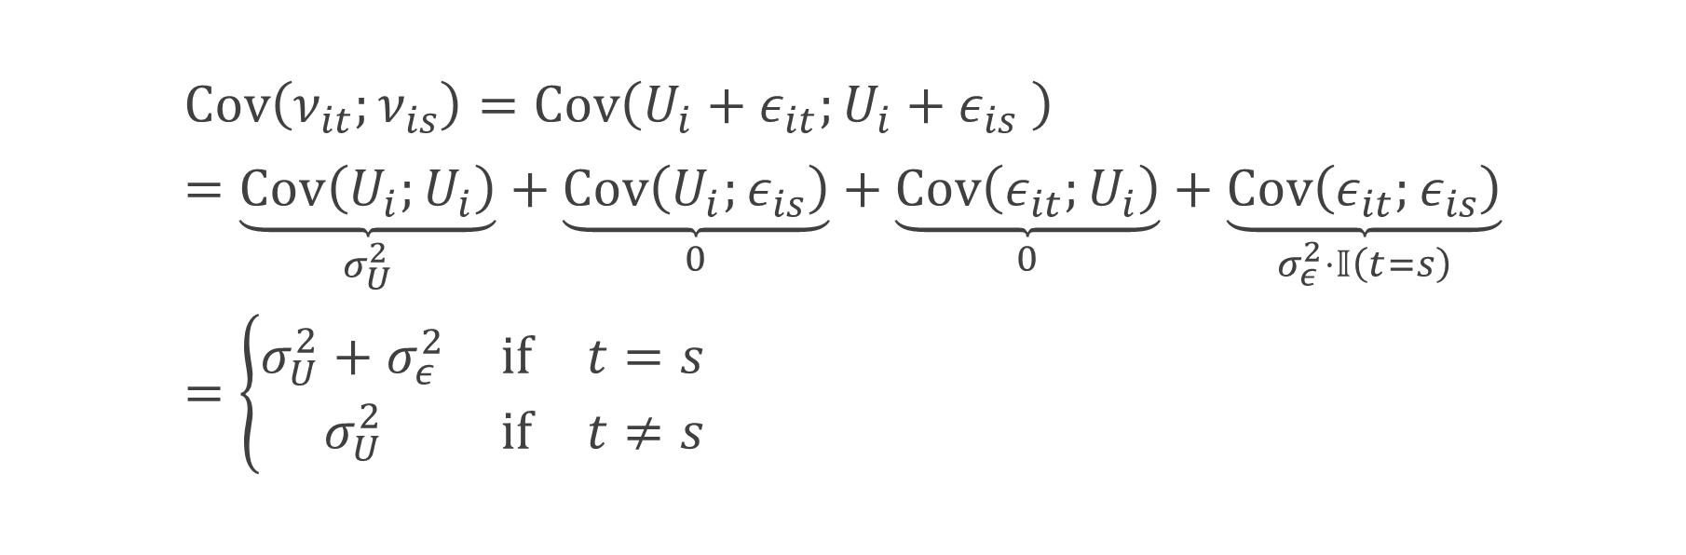
This leads to heteroskedasticity
$$Cov\left(ν_{it};ν_{is}\right)=Cov\left(U_{i}+ε_{it};U_{i}+ε_{is} \right)=\underset{σ_{U}^{2}}{\underbrace{Cov\left(U_{i};U_{i}\right)}}+\underset{0}{\underbrace{Cov\left(U_{i};ε_{is}\right)}}+\underset{0}{\underbrace{Cov\left(ε_{it};U_{i}\right)}}+\underset{σ_{ε}^{2}⋅𝕀\left(t=s\right)}{\underbrace{Cov\left(ε_{it};ε_{is}\right)}} \\ =\left\{\begin{matrix}σ_{U}^{2}+σ_{ε}^{2} & if & t=s \\ σ_{U}^{2} & if & t≠s\end{matrix}\right.$$

Slide 9

there are traditional ways of dealing with heteroskedasticity. Why not use them?
Rather than treating this as a problem of unobserved heterogeneity, we can simply treat this as a problem of heteroskedasticity!

Slide 10

Let’s do it!

Slide 11
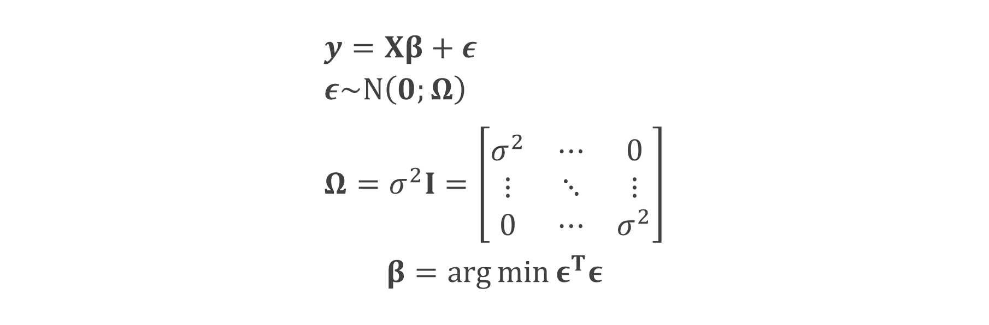
OLS refresher
$$y=Xβ+ε \\ ε\sim N\left(0;Ω\right) \\ Ω=σ^{2}I=\left[\begin{matrix}σ^{2} & ⋯ & 0 \\ ⋮ & ⋱ & ⋮ \\ 0 & ⋯ & σ^{2}\end{matrix}\right]$$
$$β=arg⁡\min{ε^{T}ε}$$

Slide 12
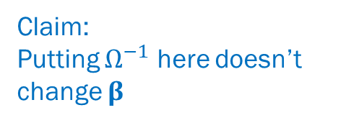
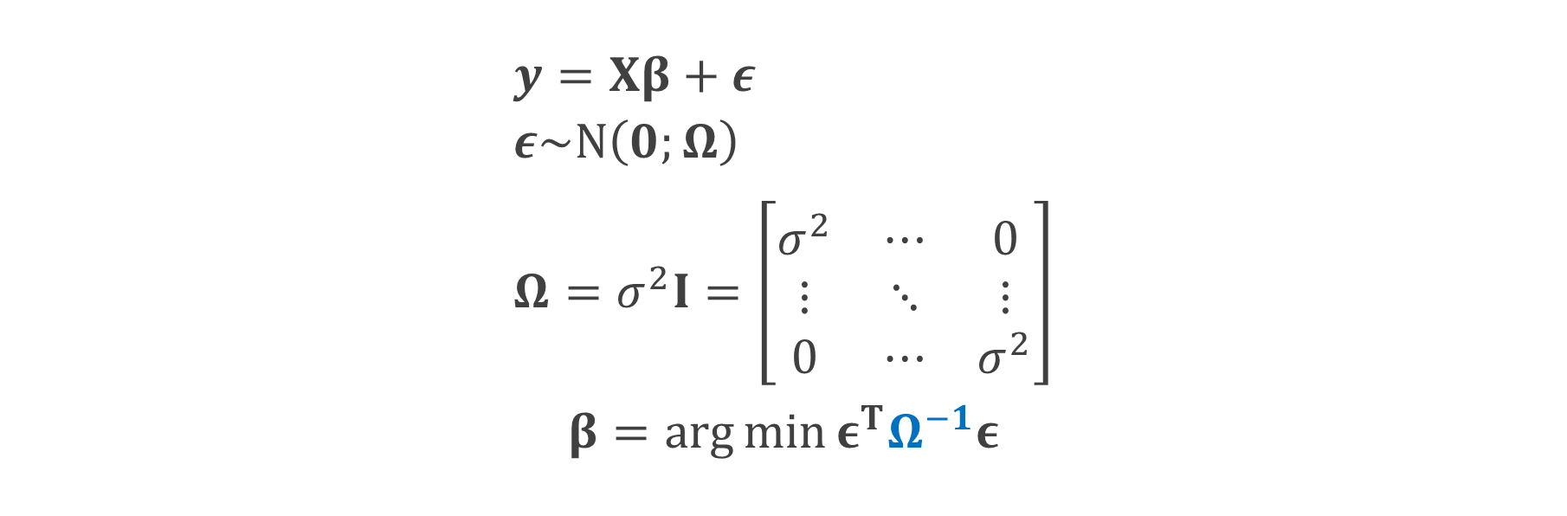
OLS refresher
$$y=Xβ+ε \\ ε\sim N\left(0;Ω\right) \\ Ω=σ^{2}I=\left[\begin{matrix}σ^{2} & ⋯ & 0 \\ ⋮ & ⋱ & ⋮ \\ 0 & ⋯ & σ^{2}\end{matrix}\right]$$
$$β=arg⁡\min{ε^{T}Ω^{−1}ε}$$
Claim:
Putting $Ω^{−1}$ here doesn’t
change $β$

Slide 13
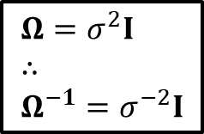

Proof
$$Ω=σ^{2}I \\ ∴ \\ Ω^{−1}=σ^{−2}I$$
$$\arg{\min{ε^{T}Ω^{−1}ε}}= \\ \arg{\min{ε^{T}σ^{−2}Iε}}= \\ \arg{\min{ε^{T}Iε}}= \\ \arg{\min{ε^{T}ε}}= \\ β$$

Slide 14
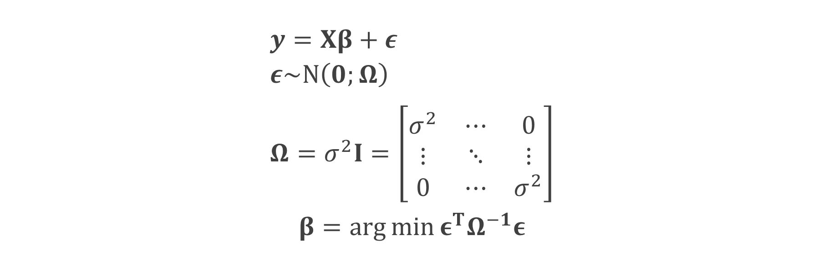
OLS in a new way
$$y=Xβ+ε \\ ε\sim N\left(0;Ω\right) \\ Ω=σ^{2}I=\left[\begin{matrix}σ^{2} & ⋯ & 0 \\ ⋮ & ⋱ & ⋮ \\ 0 & ⋯ & σ^{2}\end{matrix}\right]$$
$$β=arg⁡\min{ε^{T}Ω^{−1}ε}$$

Slide 15
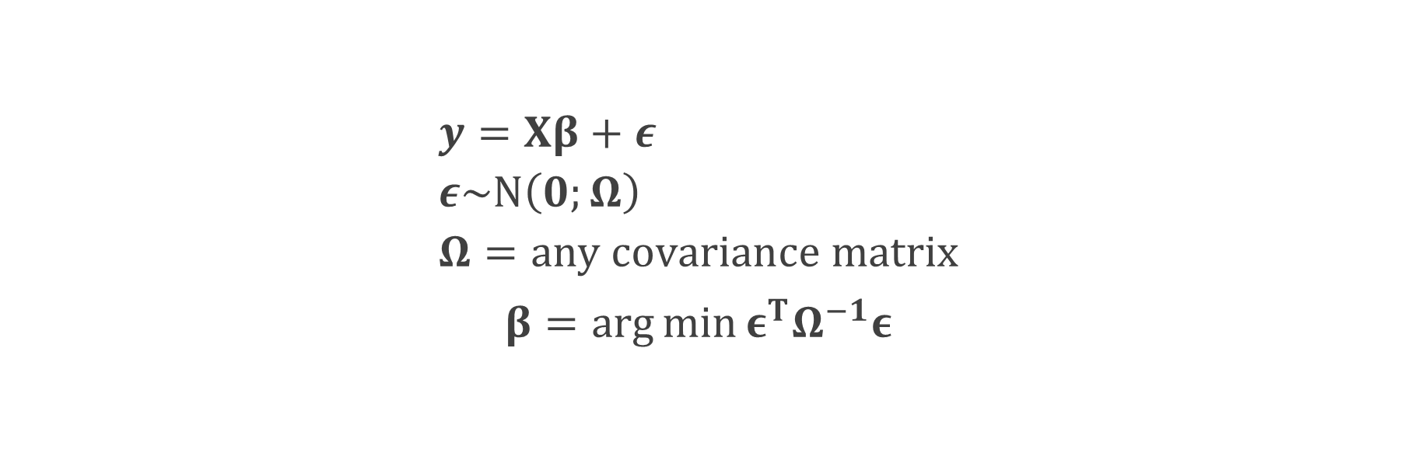
Generalized least squares (GLS) regression
$$y=Xβ+ε \\ ε\sim N\left(0;Ω\right) \\ Ω=any covariance matrix$$
$$β=arg⁡\min{ε^{T}Ω^{−1}ε}$$

Slide 16
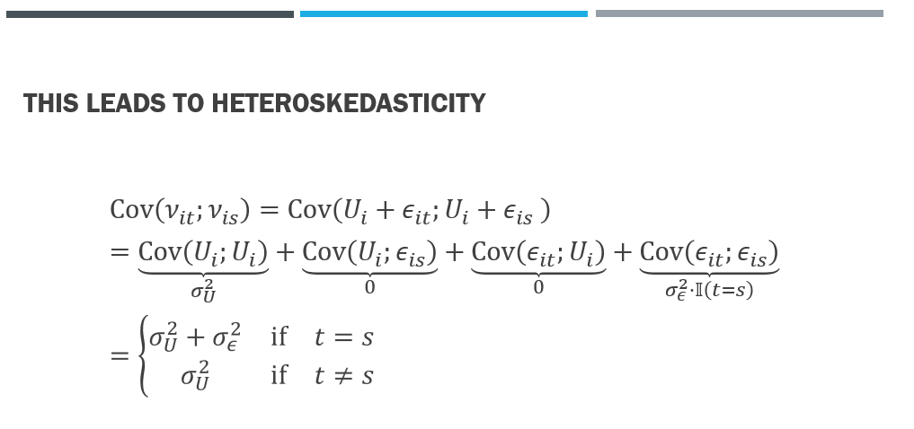
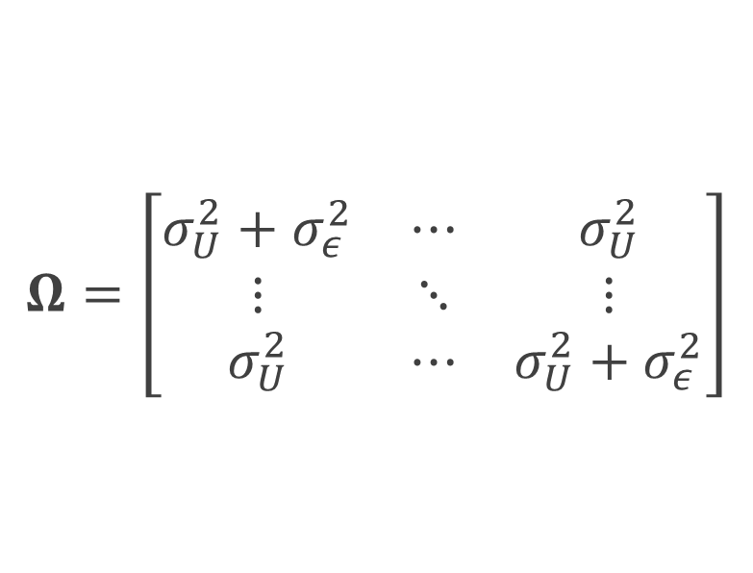
Covariance matrix of the composition error
$$Ω=\left[\begin{matrix}σ_{U}^{2}+σ_{ε}^{2} & ⋯ & σ_{U}^{2} \\ ⋮ & ⋱ & ⋮ \\ σ_{U}^{2} & ⋯ & σ_{U}^{2}+σ_{ε}^{2}\end{matrix}\right]$$

Slide 17
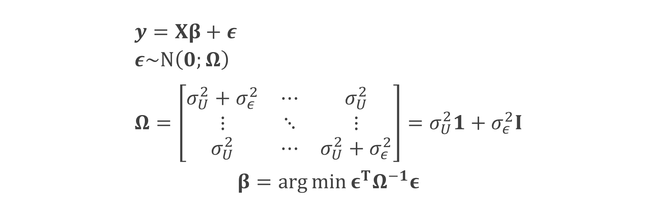
The random effects model
$$y=Xβ+ε \\ ε\sim N\left(0;Ω\right) \\ Ω=\left[\begin{matrix}σ_{U}^{2}+σ_{ε}^{2} & ⋯ & σ_{U}^{2} \\ ⋮ & ⋱ & ⋮ \\ σ_{U}^{2} & ⋯ & σ_{U}^{2}+σ_{ε}^{2}\end{matrix}\right]=σ_{U}^{2}1+σ_{ε}^{2}I$$
$$β=arg⁡\min{ε^{T}Ω^{−1}ε}$$

Slide 18

Solution to the gls problem
$$β=\arg{\min{ε^{T}Ω^{−1}ε}} \\ ={\left(y−Xβ\right)}^{T}Ω^{−1}\left(y−Xβ\right) \\ ⇓ \\ X^{T}Ω^{−1}y−X^{T}Ω^{−1}Xβ=0 \\ ∴ \\ β={\left(X^{T}Ω^{−1}X\right)}^{−1}X^{T}Ω^{−1}y$$

Slide 19
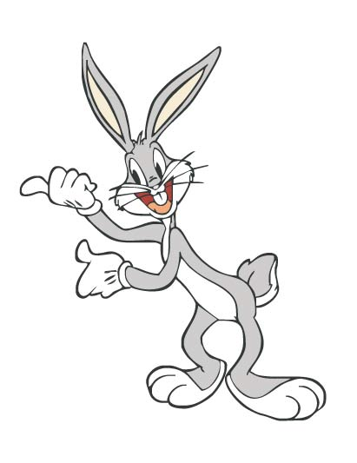

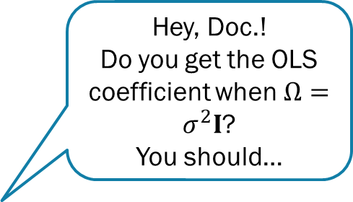
Solution to the gls problem
$$β=\arg{\min{ε^{T}Ω^{−1}ε}} \\ ={\left(y−Xβ\right)}^{T}Ω^{−1}\left(y−Xβ\right) \\ ⇓ \\ X^{T}Ω^{−1}y−X^{T}Ω^{−1}Xβ=0 \\ ∴ \\ β={\left(X^{T}Ω^{−1}X\right)}^{−1}X^{T}Ω^{−1}y$$
Hey, Doc.!
Do you get the OLS coefficient when $Ω=σ^{2}I$?
You should…

Slide 20
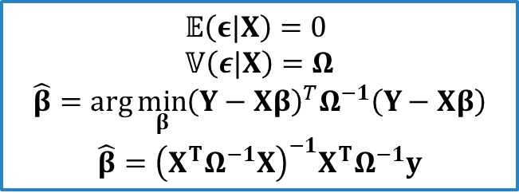
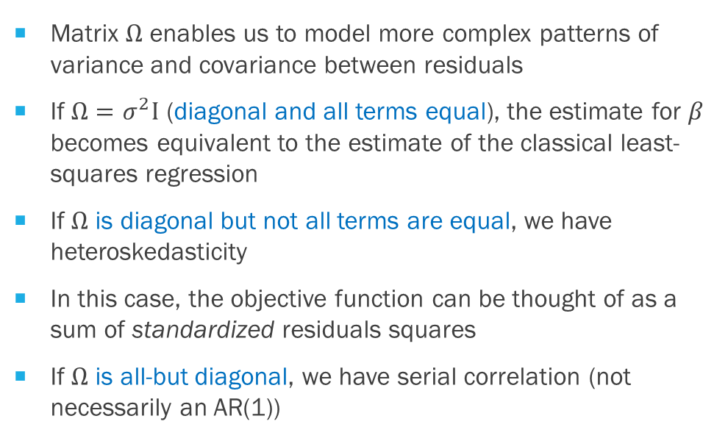
special cases of the GLS equations
Matrix $Ω$ enables us to model more complex patterns of variance and covariance between residuals
If $Ω=σ^{2}I$ (diagonal and all terms equal), the estimate for $β$ becomes equivalent to the estimate of the classical least-squares regression
If $Ω$ is diagonal but not all terms are equal, we have heteroskedasticity
In this case, the objective function can be thought of as a sum of standardized residuals squares
If $Ω$ is all-but diagonal, we have serial correlation (not necessarily an AR(1))
$$𝔼\left(ε|X\right)=0 \\ 𝕍\left(ε|X\right)=Ω$$
$$\hat{β}=\arg{\min_{β}{{\left(Y−Xβ\right)}^{T}Ω^{−1}\left(Y−Xβ\right)}}$$
$$\hat{β}={\left(X^{T}Ω^{−1}X\right)}^{−1}X^{T}Ω^{−1}y$$

Slide 21

Generalized least squares (GLS) regression
My way of thinking about
$$β_{OLS}=arg⁡\min{ε^{T}ε}$$
$$β_{GLS}=arg⁡\min{ε^{T}Ω^{−1}ε}$$
This minimizes the residual’s norm using Euclidian metric…
This minimizes the residual’s norm using Mahalanobis metric…

Slide 22


A problem with GLS is that $Ω$ is unknown!
Any ideas?

Slide 23

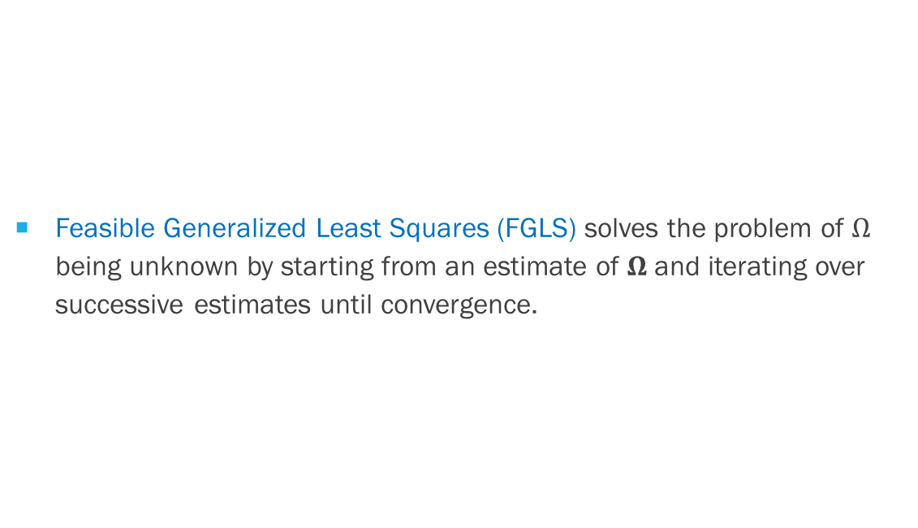
Feasible Generalized Least Squares
Feasible Generalized Least Squares (FGLS) solves the problem of $Ω$ being unknown by starting from an estimate of $Ω$and iterating over successive estimates until convergence.

Slide 24
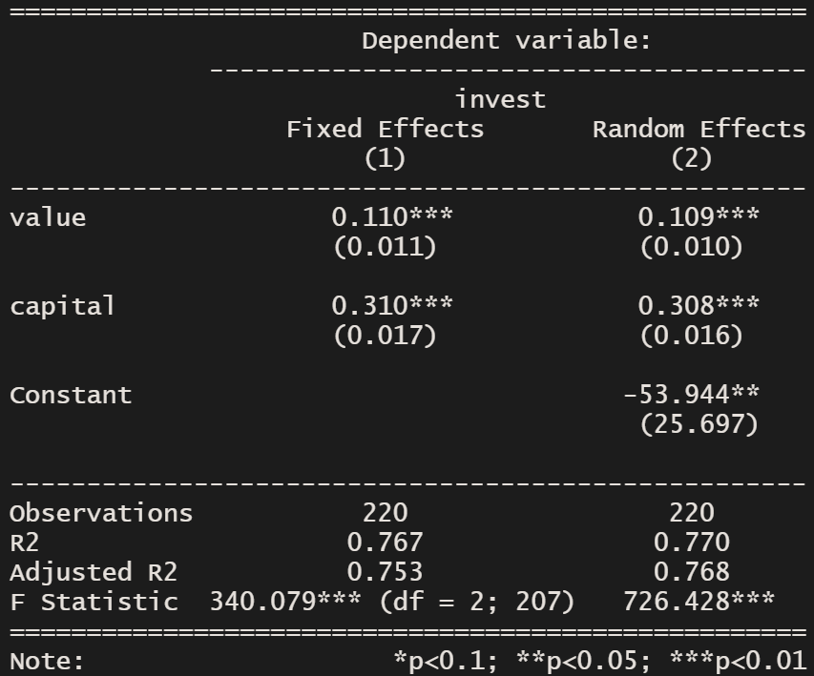
Is investment determined by company value? The Grunfeld dataset
#Random Effects model
fe <- plm(invest ~ value + capital, index=c(“firm”, “year”), data=Grunfeld, model=“random”)

Slide 25
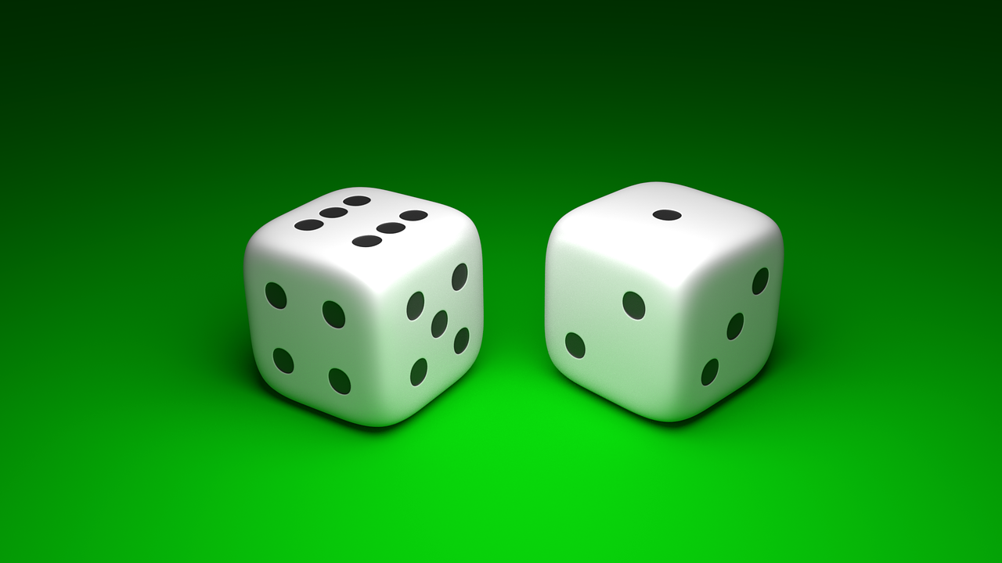
What’s “Random” in Random effects?

Slide 26
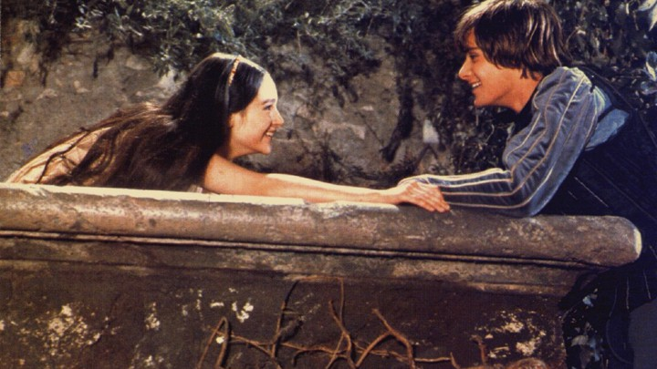
What’s in a name? That which we call a rose by any other name would smell as sweet!

Slide 27
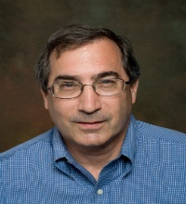
“The crucial distinction between fixed and random effects is whether the unobserved individual effect embodies elements that are correlated with the regressors in the model, not whether these effects are stochastic or not” (William H. Greene)

Slide 28
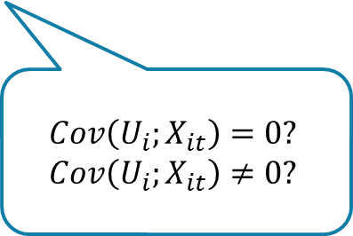
“The crucial distinction between fixed and random effects is whether the unobserved individual effect embodies elements that are correlated with the regressors in the model, not whether these effects are stochastic or not” (William H. Greene)
$$Cov\left(U_{i};X_{it}\right)=0? \\ Cov\left(U_{i};X_{it}\right)≠0?$$

Slide 29
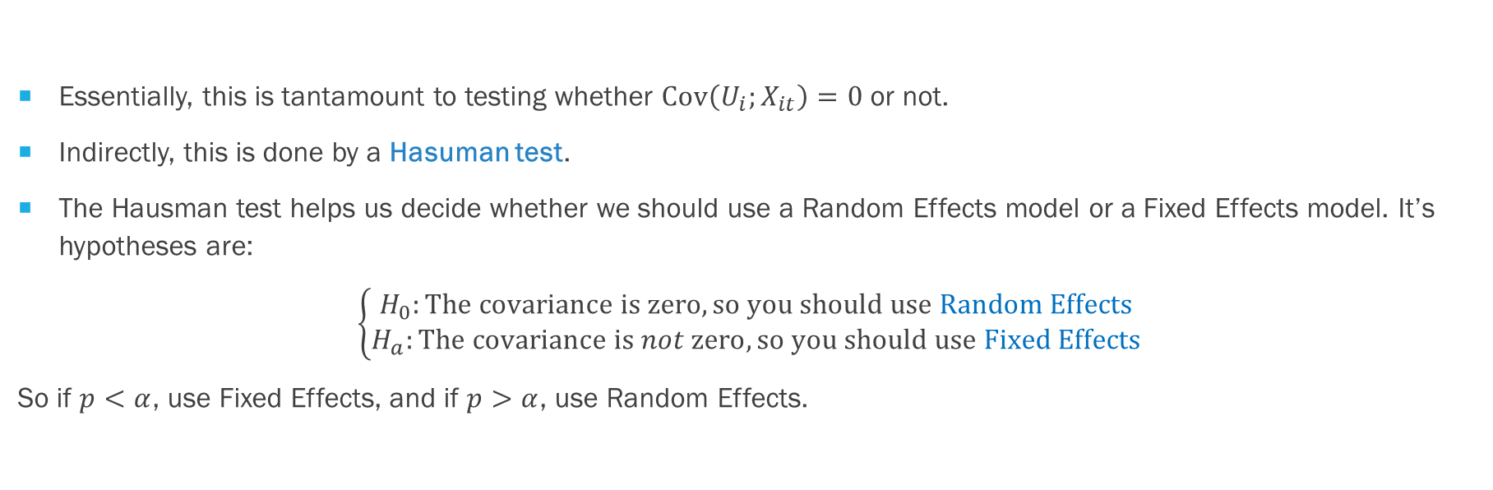
Fixed effects or random effects?
Essentially, this is tantamount to testing whether $Cov\left(U_{i};X_{it}\right)=0$ or not.
Indirectly, this is done by a Hasuman test.
The Hausman test helps us decide whether we should use a Random Effects model or a Fixed Effects model. It’s hypotheses are:
$$\left\{\begin{aligned}H_{0}:The covariance is zero, so you should use Random Effects \\ H_{a}:The covariance is not zero, so you should use Fixed Effects\end{aligned}\right.$$
So if $p<α$, use Fixed Effects, and if $p>α$, use Random Effects.

Slide 30

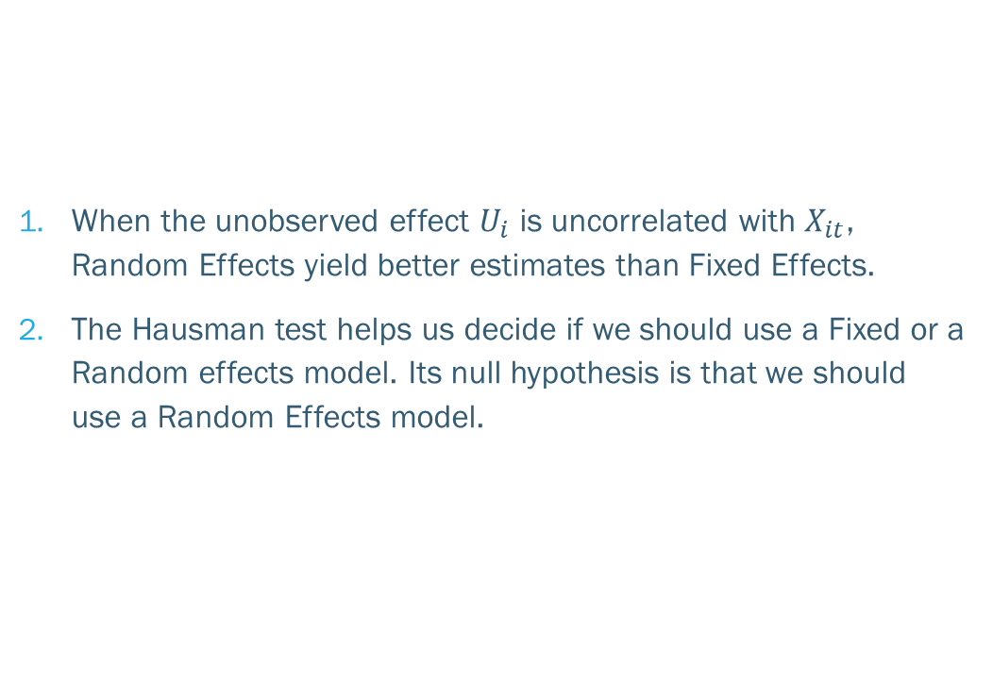
Key takeaways
When the unobserved effect $U_{i}$ is uncorrelated with $X_{it}$, Random Effects yield better estimates than Fixed Effects.
The Hausman test helps us decide if we should use a Fixed or a Random effects model. Its null hypothesis is that we should use a Random Effects model.

